Slide 1


CSE 476/575 Mobile Communication Networks AI-Based Smart Door Lock Project Report Berke Yılmaz Furkan Ayan Furkan Taşkın

Slide 2

Introduction
This project is focuses on developing secure system for home entrances
It offers a smart door lock with face recognition and mobile app for remote contolling.
Users can control the door from far away and register their faces for open the door.
AI is used for face recognition

Slide 3
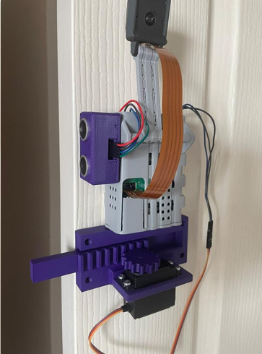
Why This Project
Providing secure system for homes unlike traditional ways
We aimed to develop an AI-based smart door lock using a Raspberry Pi with a camera for facial recognition, creating a modern and intelligent approach to home access
The system provides security by ensuring only authorized users can enter through facial recognition, and offers modern convenience with features like a mobile app for remote access

Slide 4
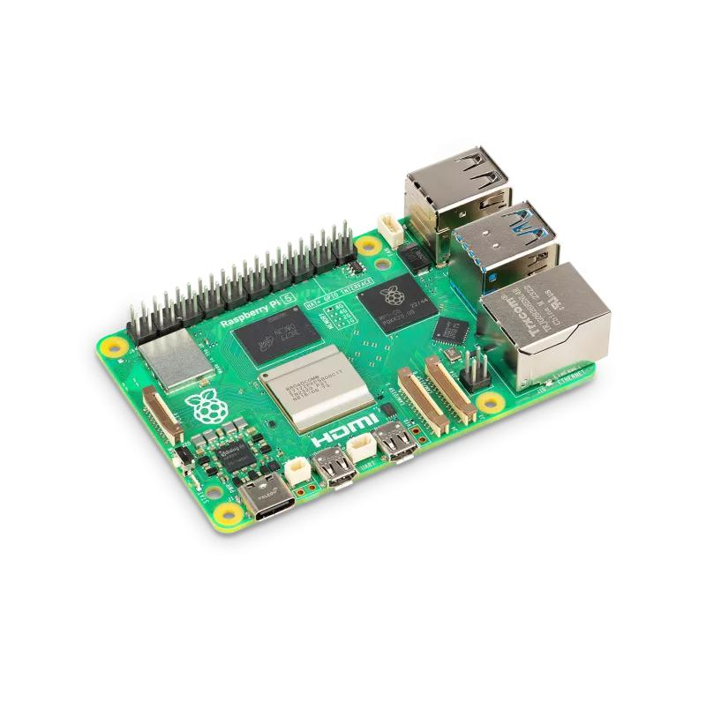
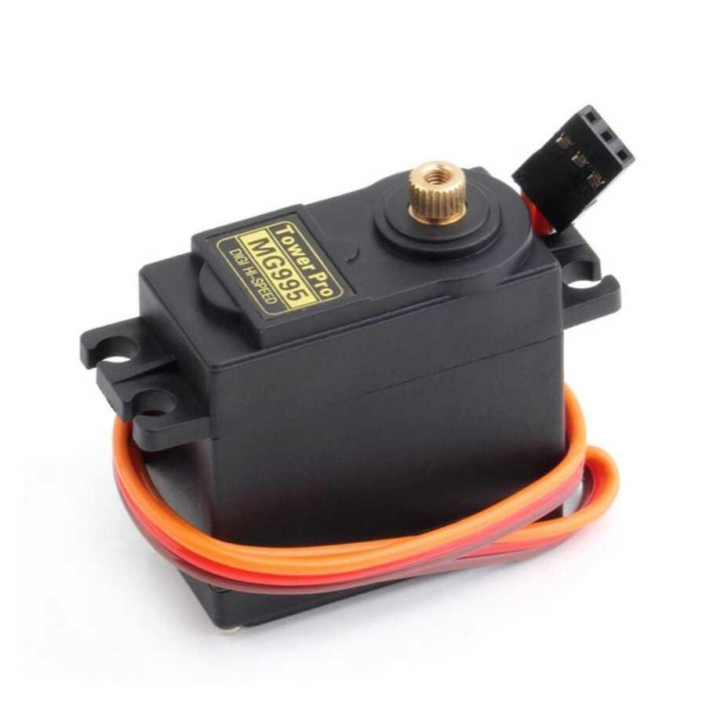
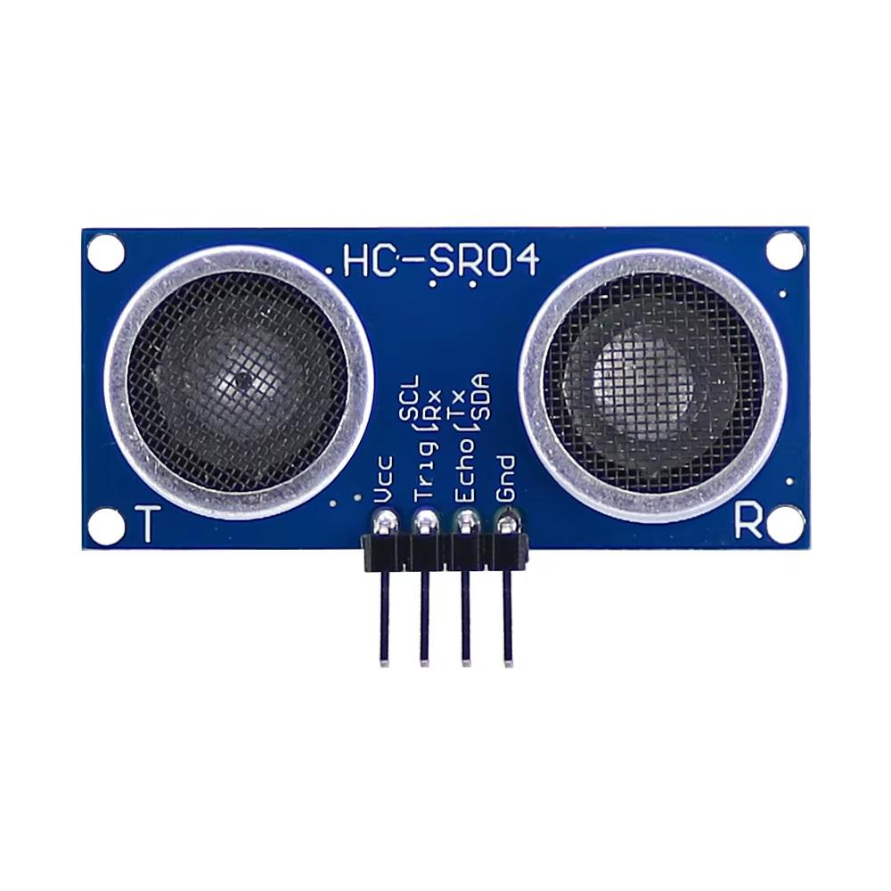
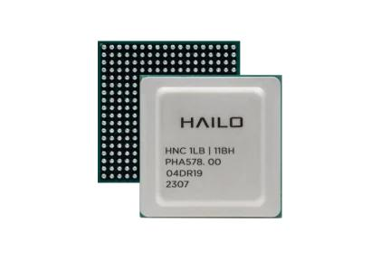
Project Requirements-1
Hardware
Servo Motor: Controls the physical locking mechanism, providing secure and reliable door operation.
Raspberry Pi 5: Serves as the central processor managing all system components and performing real-time data processing.
Hailo8L AI Kit: Enables advanced facial recognition directly at the door, ensuring instant and accurate user identification.
Ultrasonic Sensor: Monitors door status (open/closed), ensuring the lock mechanism activates appropriately for enhanced security.

Slide 5

Project Requirements-2
Backend
Django
PostgreSQL
Mobile App
React Native
Expo framework

Slide 6
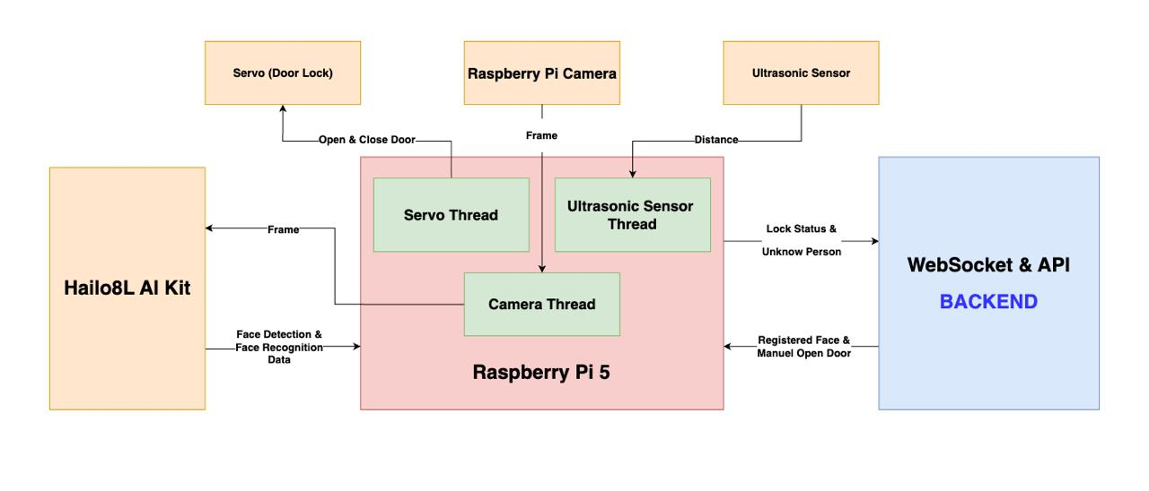
Project Architecture

Slide 7
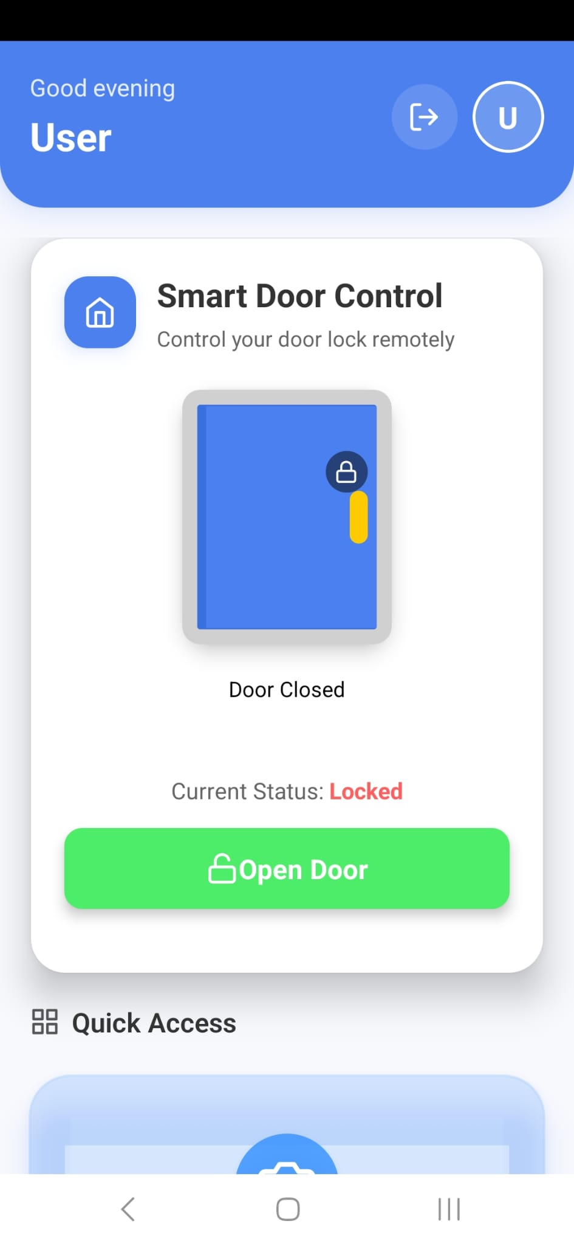
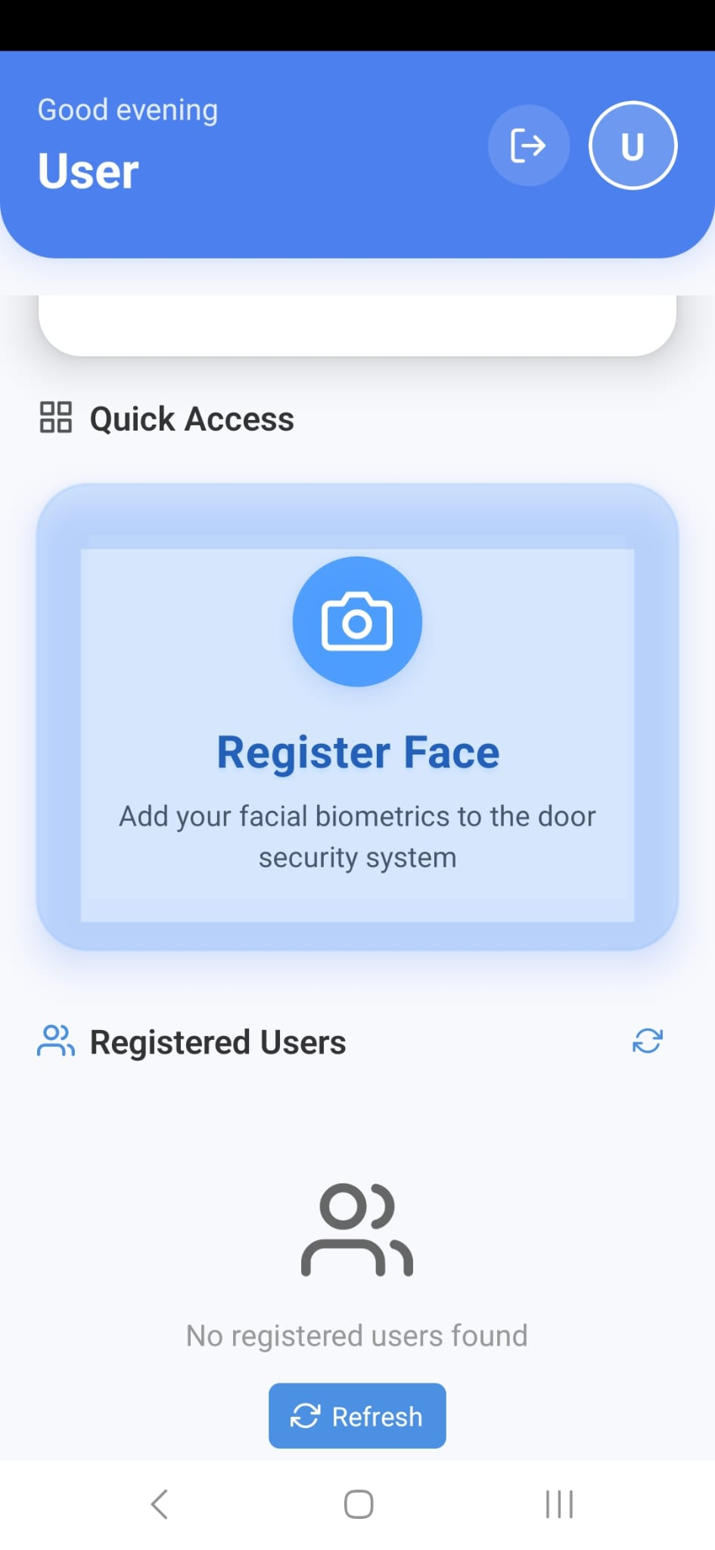
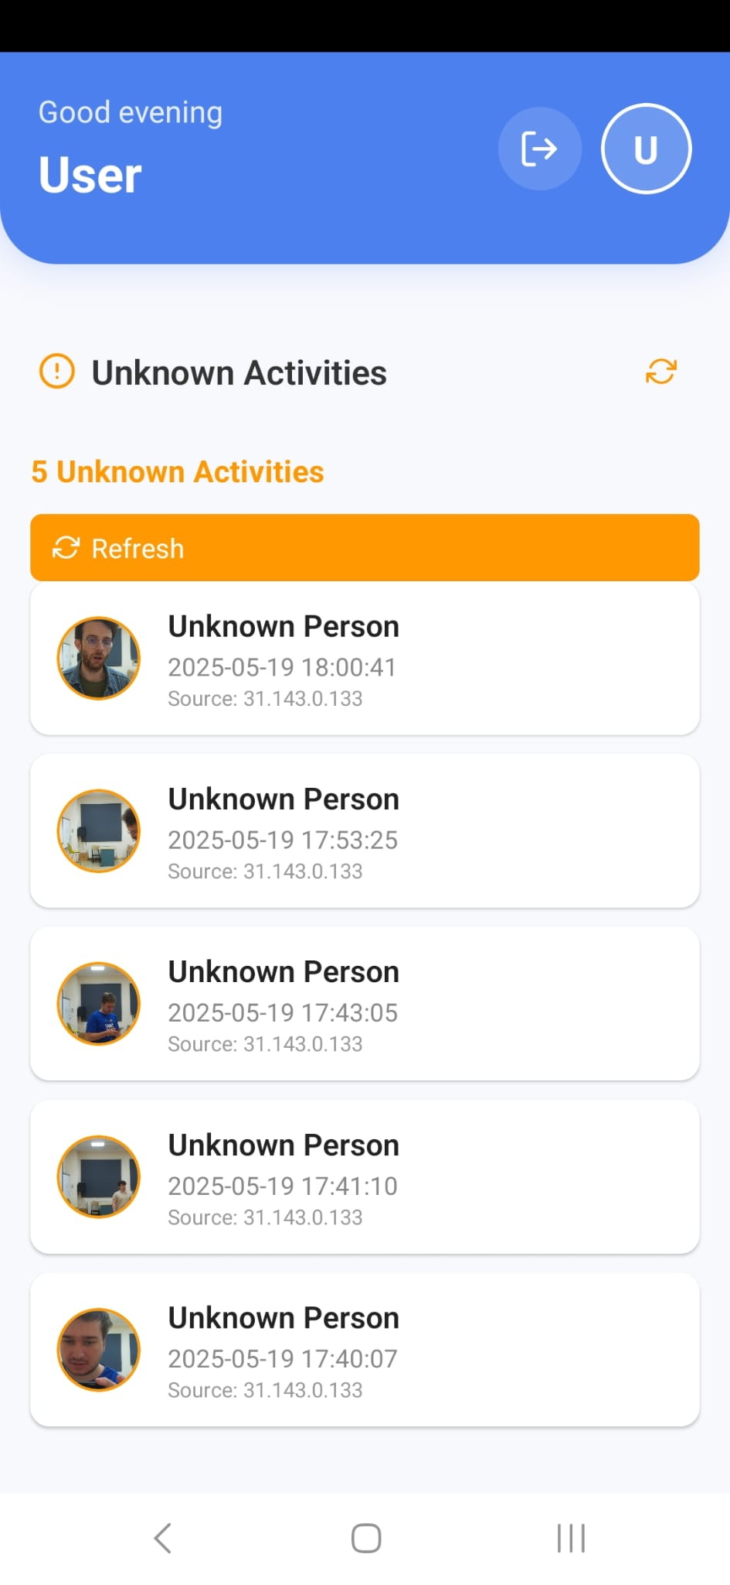
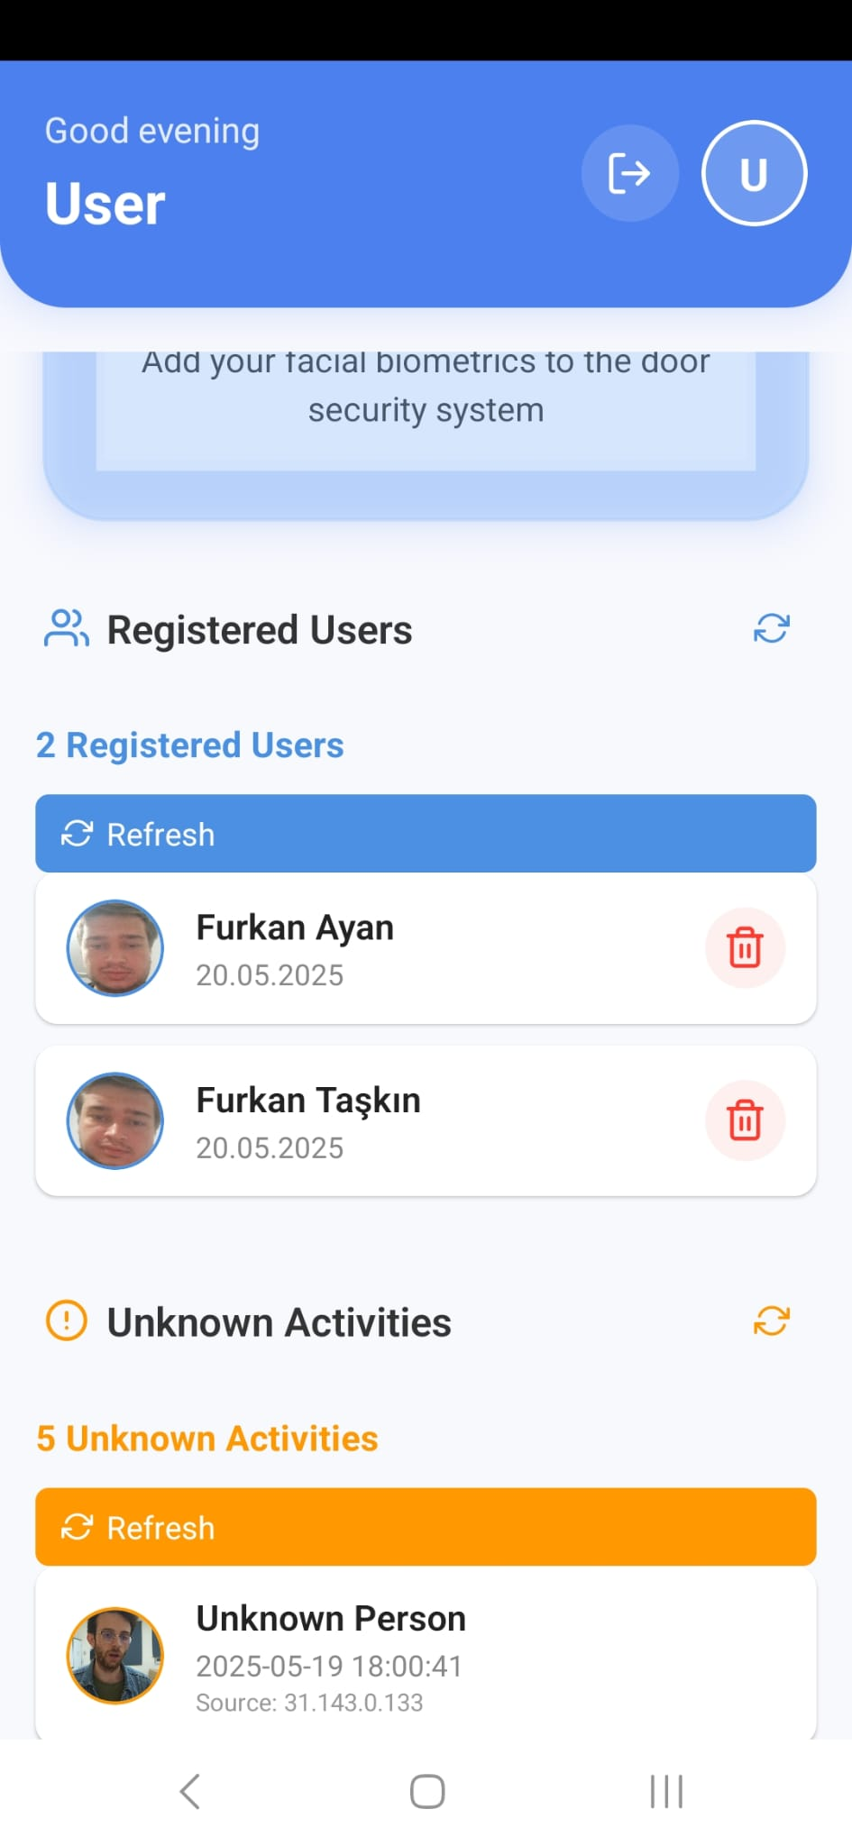
Mobile Application Screens

Slide 8
Discussion and Future Work
We can make metal parts instead of plastic ones for better security
Sending the live footage
Better mobile app UI/UX
An additional ultrasonic sensor to detect what is in the camera's line of sight.

Slide 9

THANK YOU FOR LISTENING

